Slide 1
Microsoft Excel
Excel Formulas and Functions
This Guide will teach you how to work with math functions and formulas.

Slide 2
Math and more…
You can use formulas to:
Solve mathematical problems
Complete statistical and financial functions
Return numerical and text values based on other cells
Add and format text in cells

Slide 3
Formula
Mathematical Equation
All formulas begin with an equal (=) sign
Data that is stored in the worksheet and that needs to be used in a formula is referenced using the cell’s address
=A1+A2/(A3-A4)

Slide 4
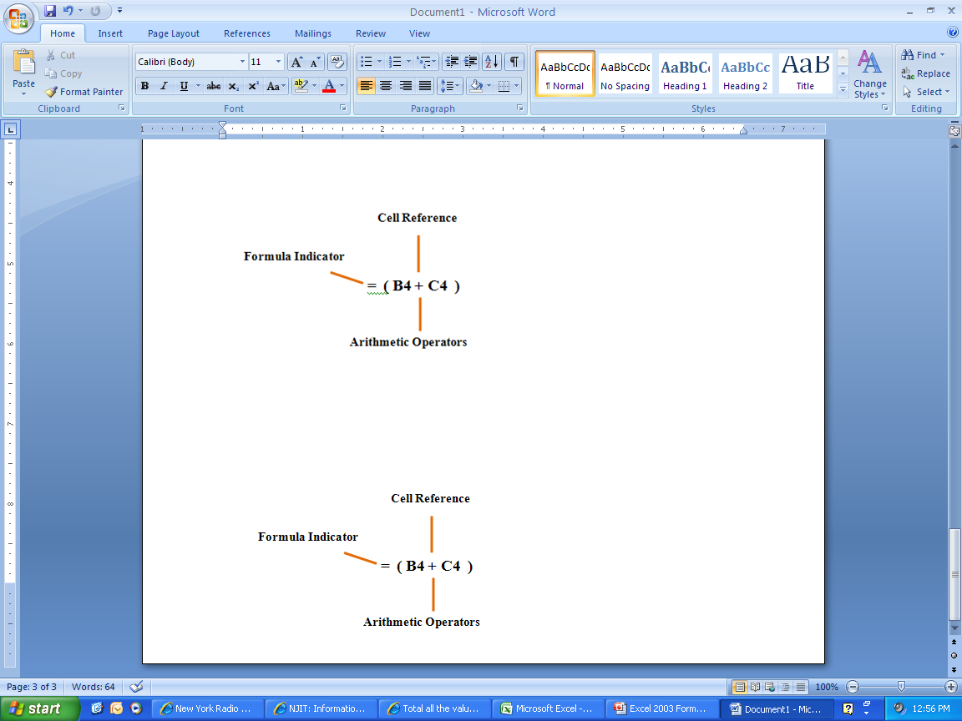
An example of a simple formula

Slide 5
Functions
A predefined formula
Formula: =A1+A2+A3+A4+A5
Function: =SUM(A1:A5)

Slide 6
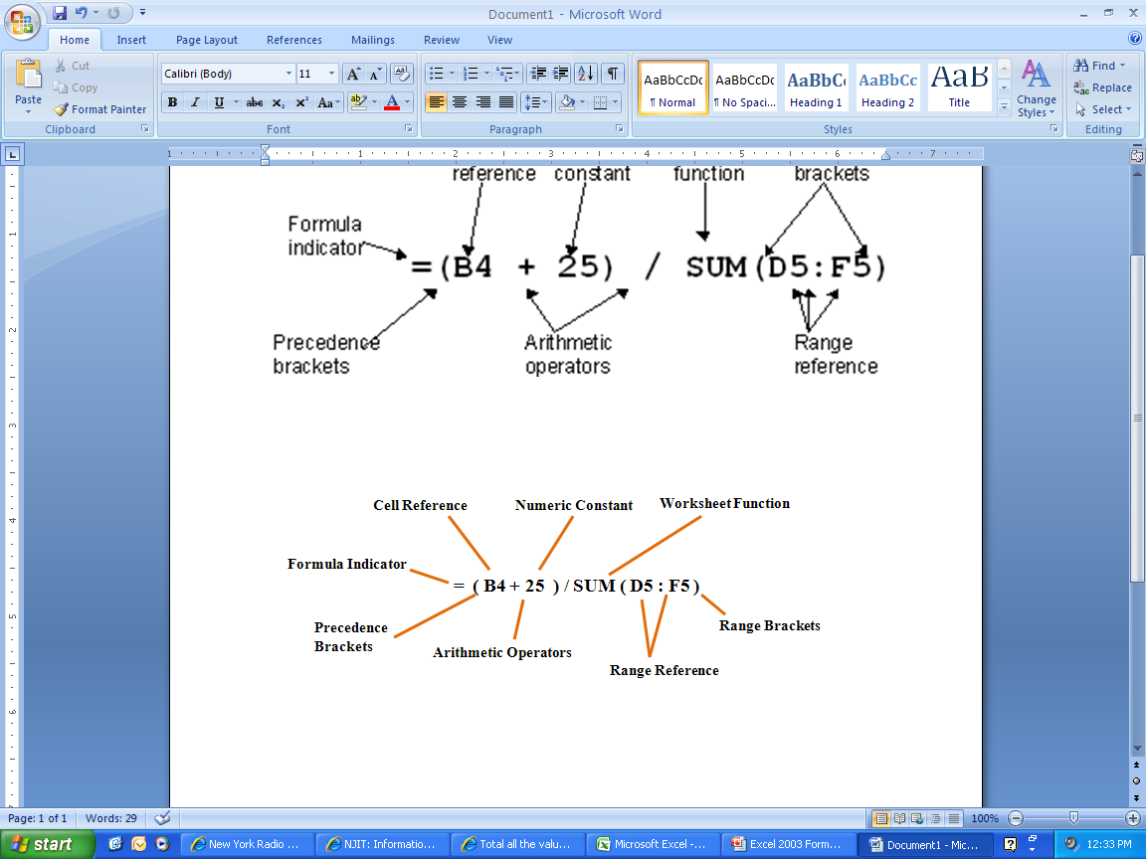
An example of a more complex formula

Slide 7
What makes a formula?
=(3*$A$2*SUM(A3:A9))^1/3
Begin with =
Constants
Cell References
Operators
Functions

Slide 8
Constants
Values entered directly into a formula
  Simple
  Accurate
  Inflexible
  2, 3, 12, 14.32

Slide 9
References
Relative (Column Row)
  A1, C18, ZZ65536
Absolute ($Column$Row)
  $A$1, $C$18,$ZZ$65536
Mixed (Fixed Column or Row)
  $A1, C$18
Named Ranges
  Int_Rate, Grade_Scale

Slide 10
Operators
Arithmetic
  - (negative) % ^ (Exponent) * / +
Comparison
  = < > <= >= <>
Text
  &
Reference
  : (Colon) _ (Space) , (Comma)

Slide 11
Operator Order
Formulas are read from Left to Right
( )
Negation
%
^
* or /
+ or –
&
= < > <= >= <>

Slide 12
Error Messages (Cell Reference)
######### | Column not wide enough
#VALUE! | Wrong Argument or Reference
#DIV/0! | Dividing by zero
#Name? | Excel doesn’t recognize text in formula
#N/A! | Missing data or wrong value for lookup function
#REF | Cell reference not valid (Deleted cell, pasted over)
#NUM! | Invalid numeric value
#NULL! | Specified cells do not intersect

Slide 13
How to Copy Formulas?
AutoFill is a command you can use when you want to copy the same formula across a range of adjacent cells.
AutoFill will automatically change cell addresses depending on where the new formula is being copied.

Slide 14
An example of a
Simple Formula
and a Complex
formula

Slide 15
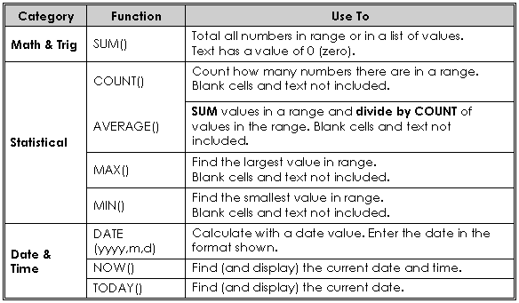

Slide 16
Open Excel worksheet and enter the data below:
SalesRep Month Amount
Jones Jan 100
Jones Jan 225
Rogers Jan 400
Rogers Jan 150
Rogers Jan 250
Franklin Jan 800
Franklin Feb 200
Jones Feb 350
Franklin Feb 1200
Rogers Feb 900
Sum:
Average:
Count:

Slide 17
Add values
Within a certain range:
  =SUM(C2:C13)
For an entire range:
  =SUM(C:C) Note: Insert this function in another column.

Slide 18
Count values
Count values in a range and it the entire range:
=COUNT(C2:C13)
=COUNT(C:C)
Conditional Counting:
=COUNTIF(A2:A13, “Jones”) or
=COUNTIF(A2:A13, “=Jones”) – equal
=COUNTIF(A2:A13, “<> Jones”) – not equal

Slide 19
Cont…
Count the Number of Sales Greater than a Target Value:
  =COUNTIF(C2:C13, “>”&D1)
  Note: the concatenation operator (&) is used to join the grater than symbol (>) with the cell reference.
Count the Number of Sales Greater than the Sales Average:
  =COUNTIF(C2:C13, “>”&AVERAGE(C2:C13))

Slide 20
Conditional Summing
Formula that adds all the sales in January:
  =SUMIF(B2:B13, “=Jan”, C2:C13)
Add up sales made by other sales representative:
  =SUMIF(A2:A13, “<> Rogers”, C2:C13)
Add up the sales greater than a certain value:
  =SUMIF(C2:C13, “>500”,C2:C13)
Range
Sum range
Criteria

Slide 21
Using the IF Function
Display a value that depends on criteria you set
Returns a value if one condition is true and returns another value if the condition is false
=IF(logical_test,value_if_true,value_if_false)
Notes:
The IF worksheet function
Suppose that your company determines sales bonuses on a sliding scale, awarding either 10 percent or 15 percent, based on the invoice amount. To determine which one of two values to use, based on a condition that is either true or false, use the IF worksheet function.
The IF worksheet function returns a bonus of either 10% or 15%, based on the invoice amount.
The IF worksheet function checks a condition that must be either true or false. If the condition is true, the function returns one value; if the condition is false, the function returns another value. The function has three arguments: the condition you want to check, the value to return if the condition is true, and the value to return if the condition is false.
=IF(logical_test,value_if_true,value_if_false)
=iF(b4<10000,10%,15%)
For Suyama's $8,000 invoice, the function (in cell C4) looks like this:
=IF(B4<10000,10%,15%)
Other possibilities:
=IF(b2>300, “Good”, “Try again…”)
=IF(B10>90, “A”,if(B10>80, “B”,if (B10>70, “C”,if (B10>60, “D”, “F”))))
If the invoice amount is less than $10,000 (the logical_test argument), the bonus is 10 percent (the value_if_true argument). If the invoice amount is $10,000 or greater, the bonus is 15 percent (the value _if_false argument).

Slide 22
PMT function
Function used to calculate a loan payment amount using principal, interest rate and number of payment periods.
=PMT(rate, nper,pv)
=PMT( .09/12,4*12,24000)

Slide 23
Calculating time period
Each day, month, and year is given a particular numerical value or serial number by your computer.
Your computer will work from 1900 date system or 1904 date system
1900 date system: Jan 1, 1900 –Dec 31, 9999
1904 date system: Jan 2, 1904 – Dec31, 9999
To check go to Tools – Options – Calculation

Slide 24
If you have any questions, please feel free to contact Excel Expert
Aiman Saleem
+92 345 0090150
Web http://www.excel-expert.yolasite.com
e-mail aiman.ramzanali@gmail.com

