Slide 1
Microsoft® Office
Excel® 2007 Training
Excel Expert
Prepared By: Aiman Saleem
www.excel-expert.yolasite.com
Notes:
Before you begin: If you want to teach people the basics of creating a workbook and entering and editing text and numbers, take a look at the Microsoft Office Online training presentation called “Excel 2007—Create your first workbook.” Office Online also offers a training presentation that provides an overview of the new look in Excel 2007 called “Excel 2007—Get up to speed.”

Slide 2
Course contents
Overview: Goodbye, calculator
Lesson 1: Get started
Lesson 2: Use cell references
Lesson 3: Simplify formulas by using functions
Each lesson includes a list of suggested tasks and a set of test questions.

Slide 3

Overview: Goodbye, calculator
Excel is great for working with numbers and math. In this course you’ll learn how add, divide, multiply, and subtract by typing formulas into Excel worksheets.
You’ll also learn how to use simple formulas that automatically update their results when values change.
After picking up the techniques in this course, you’ll be able to put your calculator away for good.

Slide 4
Course goals
Do math by typing simple formulas to add, divide, multiply, and subtract.
Use cell references in formulas, so that Excel can automatically update results when values change or when you copy formulas.
Use functions (prewritten formulas) to add up values, calculate averages, and find the smallest or largest value in a range of values.

Slide 5
Lesson 1
Get started

Slide 6
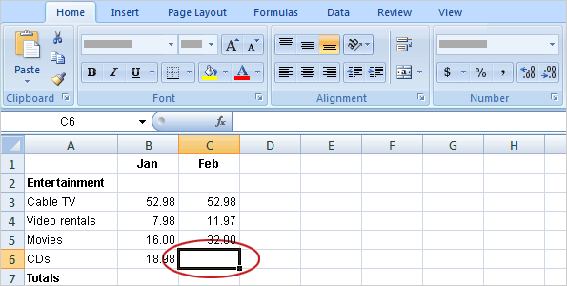
Get started
Imagine that Excel is open and you’re looking at the “Entertainment” section of a household expense budget.
Cell C6 in the worksheet is empty; the amount spent for CDs in February hasn’t been entered yet.
In this lesson, you’ll learn how to use Excel to do basic math by typing simple formulas into cells. You’ll also learn how to total all the values in a column with a formula that updates its result if values change later.
Notes:
CD in this case stands for “compact discs.”

Slide 7
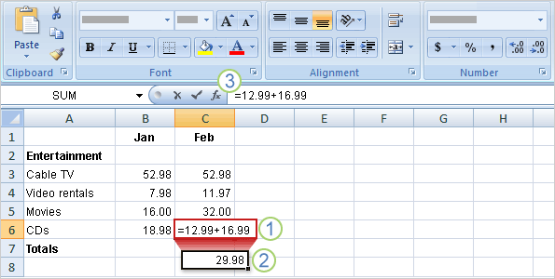
Begin with an equal sign
The two CDs purchased in February cost $12.99 and $16.99.
The total of these two values is the CD expense for the month.
You can add these values in Excel by typing a simple formula into cell C6.

Slide 8
Begin with an equal sign
The picture illustrates what to do.
Type a formula in cell C6. Excel formulas always begin with an equal sign. To add 12.99 and 16.99, type:
=12.99+16.99
The plus sign (+) is the math operator that tells Excel to add the values.

Slide 9
Begin with an equal sign
The picture illustrates what to do.
Press ENTER to display the formula result.
If you wonder later how you got this result, you can click in cell C6 any time and view the formula in the formula bar near the top of the worksheet.

Slide 10
Use other math operators
Math operators
Add (+) | =10+5
Subtract (-) | =10-5
Multiply (*) | =10*5
Divide (/) | =10/5
To do more than add, use other math operators as you type formulas into worksheet cells.
Excel uses familiar signs to build formulas.
As the table shows, use a minus sign (-) to subtract, an asterisk (*) to multiply, and a forward slash (/) to divide.
Remember to always start each formula with an equal sign.
Notes:
Note: You could use more than one math operator in a single formula. This training presentation covers only single-operator formulas, but you should know that if there’s more than one operator, formulas are not just calculated from left to right. The rules of operator precedence and two example formulas are on the Quick Reference Card that’s linked to at the end of this course.

Slide 11
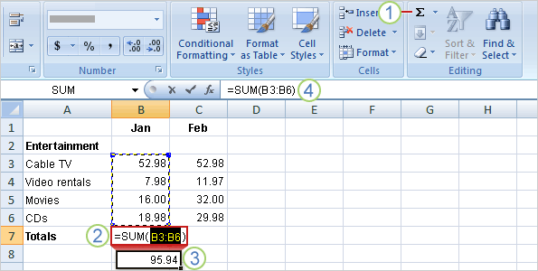
Total all the values in a column
To add up the total of expenses for January, you don’t have to type all those values again.
Instead, you can use a prewritten formula called a function.
To get the January total, click in cell B7 and then:
On the Home tab, click the Sum button in the Editing group.
A color marquee surrounds the cells in the formula, and the formula appears in cell B7.
Notes:
Pressing the Sum button enters the SUM function, which adds up all the values in a range of cells. To save time, use this function whenever you have more than a few values to add up, so that you don’t have to type the formula.

Slide 12
Total all the values in a column
To add up the total of expenses for January, you don’t have to type all those values again.
Instead, you can use a prewritten formula called a function.
To get the January total, click in cell B7 and then:
Press ENTER to display the result in cell B7: 95.94.
Click in cell B7 to display the formula =SUM(B3:B6) in the formula bar.

Slide 13
Total all the values in a column
B3:B6 is the information, called the argument, that tells the SUM function what to add.
By using a cell reference (B3:B6) instead of the values in those cells, Excel can automatically update results if values change later on.
The colon (:) in B3:B6 indicates a cell range in column B, rows 3 through 6. The parentheses are required to separate the argument from the function.
Notes:
The next two lessons explain cell references and functions in more detail.
Tip: The Sum button is also on the Formulas tab. While you can work with formulas no matter what tab you work on, you might switch to the Formulas tab to work with more complex formulas (which aren’t covered by this training presentation).

Slide 14
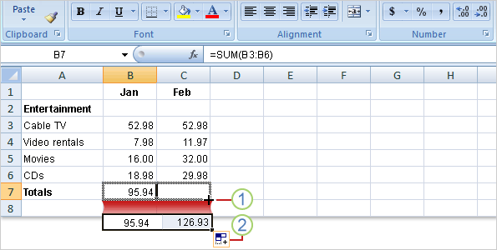
Copy a formula instead of creating a new one
Sometimes it’s easier to copy formulas than to create new ones.
In this section, you’ll see how to copy the formula you used to get the January total and use it to add up February’s expenses.

Slide 15
Copy a formula instead of creating a new one
First, select cell B7.
Then position the mouse pointer over the lower-right corner of the cell until the black cross (+) appears.
Next, as the picture shows:
Drag the fill handle from cell B7 to cell C7, and release the fill handle. The February total 126.93 appears in cell C7.
The formula =SUM(C3:C6) will also become visible in the formula bar near the top of the worksheet.
Notes:
Cell B7, you might remember, contains the January formula. Cell C7 is where you want to copy the formula.
Note: You can drag the fill handle to copy formulas only into cells that are next to each other, either horizontally or vertically.

Slide 16
Copy a formula instead of creating a new one
First, select cell B7.
Then position the mouse pointer over the lower-right corner of the cell until the black cross (+) appears.
Next, as the picture shows:
The Auto Fill Options button appears to give you some formatting options. In this case, you don’t need formatting options, so no action is required. The button disappears when you next make an entry in the cell.

Slide 17
Suggestions for practice
Create a formula for addition.
Create other formulas.
Add up a column of numbers.
Add up a row of numbers.
Online practice (requires Excel 2007)
Notes:
[Note to trainer: With Excel 2007 installed on your computer, you can click the link in the slide to go to an online practice. In the practice, you can work through each of these tasks in Excel, with instructions to guide you. Important: If you don’t have Excel 2007, you won’t be able to access the practice instructions.]

Slide 18
Test 1, question 1
What do you type into an empty cell to start a formula? (Pick one answer.)
*
(
=

Slide 19
Test 1, question 1: Answer
=
An equal sign (=) tells Excel that a calculation follows it.

Slide 20
Test 1, question 2
What is a function? (Pick one answer.)
A prewritten formula.
A math operator.

Slide 21
Test 1, question 2: Answer
A prewritten formula.
Functions are prewritten formulas, such as SUM, that save time.

Slide 22
Test 1, question 3
A formula result is in cell C6. You wonder how you got the result. To see the formula, what do you do? (Pick one answer.)
Click in cell C6, and then press CTRL+SHIFT.
Click in cell C6, and then press F5.
Click in cell C6.

Slide 23
Test 1, question 3: Answer
Click in cell C6.
It’s that simple. The formula is visible in the formula bar near the top of the worksheet whenever you click in cell C6. Or you can double-click cell C6 to see the formula in cell C6. Then press ENTER to see the formula result again in the cell.

Slide 24
Lesson 2
Use cell references

Slide 25
Use cell references
Cell references | Refer to values in
A10 | the cell in column A and row 10
A10,A20 | cell A10 and cell A20
A10:A20 | the range of cells in column A and rows 10 through 20
B15:E15 | the range of cells in row 15 and columns B through E
A10:E20 | the range of cells in columns A through E and rows 10 through 20
Cell references identify individual cells or cell ranges in columns and rows.
Cell references tell Excel where to look for values to use in a formula.
Excel uses a reference style called A1, which refers to columns with letters and to rows with numbers. The numbers and letters are called row and column headings.
This lesson shows how Excel can automatically update the results of formulas that use cell references, and how cell references work when you copy formulas.
Notes:
The table shows how to refer to cells by using the column letter followed by the row number.
The first section in this lesson describes what happens if the value in a cell changes after a total is calculated.

Slide 26
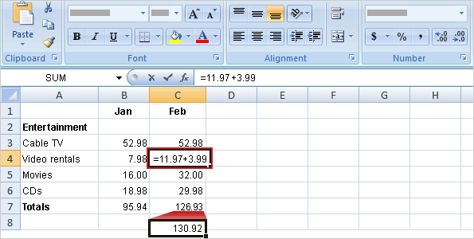
Update formula results
Suppose the 11.97 value in cell C4 was incorrect. A 3.99 video rental was left out.
Excel can automatically update totals to include changed values.
To add 3.99 to 11.97, you would click in cell C4, type the following formula into the cell, and then press ENTER:
=11.97+3.99

Slide 27
Update formula results
As the picture shows, when the value in cell C4 changes, Excel automatically updates the February total in cell C7 from 126.93 to 130.92.
Excel can do this because the original formula =SUM(C3:C6) in cell C7 contains cell references.
If you had entered 11.97 and other specific values into a formula in cell C7, Excel would not be able to update the total. You’d have to change 11.97 to 15.96 not only in cell C4, but in the formula in cell C7 as well.
Notes:
Note: You can revise a formula in a selected cell by typing either in the cell or in the formula bar.

Slide 28
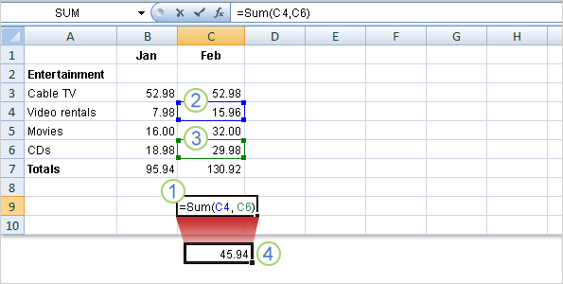
Other ways to enter cell references
You can type cell references directly into cells, or you can enter cell references by clicking cells, which avoids typing errors.
In the first lesson you saw how to use the SUM function to add all the values in a column.
You could also use the SUM function to add just a few values in a column, by selecting the cell references to include.

Slide 29
Other ways to enter cell references
Imagine that you want to know the combined cost for video rentals and CDs in February.
The example shows you how to enter a formula into cell C9 by clicking cells.
In cell C9, type the equal sign, type SUM, and type an opening parenthesis.
Click cell C4. The cell reference for cell C4 appears in cell C9. Type a comma after it in cell C9.
Notes:
Why enter the formula in cell C9? C9 is used for example purposes. You don’t need to store the total, so you can enter the formula in any empty cell and delete it later.

Slide 30
Other ways to enter cell references
Imagine that you want to know the combined cost for video rentals and CDs in February.
The example shows you how to enter a formula into cell C9 by clicking cells.
Click cell C6. That cell reference appears in cell C9 following the comma. Type a closing parenthesis after it.
Press ENTER to display the formula result, 45.94.
A color marquee surrounds each cell as it is selected and disappears when you press ENTER to display the result.
Notes:
As always, the formula appears in the formula bar near the top of the worksheet whenever cell C9 is selected.

Slide 31
Other ways to enter cell references
Here’s a little more information about how this formula works.
The arguments C4 and C6 tell the SUM function what values to calculate with. The parentheses are required to separate the arguments from the function.
The comma, which is also required, separates the arguments.

Slide 32
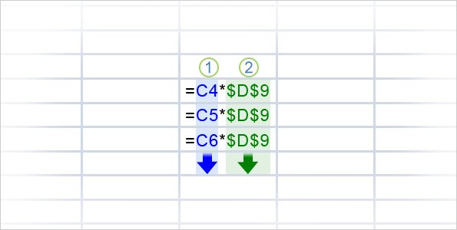
Reference types
Now that you’ve learned about using cell references, it’s time to talk about the different types.
The picture shows two types, relative and absolute.
Relative references automatically change as they’re copied down a column or across a row.
When the formula =C4*$D$9 is copied from row to row in the picture, the relative cell references change from C4 to C5 to C6.
Notes:
The workings of relative references account for why, in the first lesson, you could copy the January formula to add up February expenses.

Slide 33
Reference types
Now that you’ve learned about using cell references, it’s time to talk about the different types.
The picture shows two types, relative and absolute.
Absolute references are fixed. They don’t change if you copy a formula from one cell to another. Absolute references have dollar signs ($) like this: $D$9.
As the picture shows, when the formula =C4*$D$9 is copied from row to row, the absolute cell reference remains as $D$9.
Notes:
The next lesson will go into more detail about why you’d use an absolute reference.

Slide 34
Reference types
There’s one more type of cell reference.
The mixed reference has either an absolute column and a relative row, or an absolute row and a relative column.
For example, $A1 is an absolute reference to column A and a relative reference to row 1.
As a mixed reference is copied from one cell to another, the absolute reference stays the same but the relative reference changes.

Slide 35
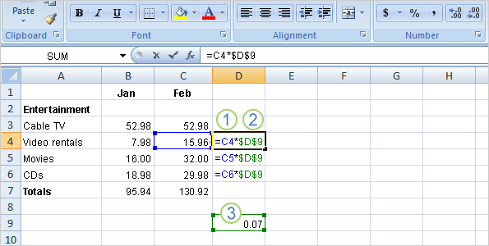
Using an absolute cell reference
You use absolute cell references to refer to cells that you don’t want to change as the formula is copied.
References are relative by default, so you would have to type dollar signs, as shown by callout 2 in the picture, to change the reference type to absolute.

Slide 36
Using an absolute cell reference
Say you receive some entertainment coupons offering a
7 percent discount for video rentals, movies, and CDs. How much could you save in a month by using the discounts?
You could use a formula to multiply those February expenses by 7 percent.
So start by typing the discount rate .07 in the empty cell D9, and then type the formula in cell D4.

Slide 37
Using an absolute cell reference
Say you receive some entertainment coupons offering a
7 percent discount for video rentals, movies, and CDs. How much could you save in a month by using the discounts?
Then in cell D4, type =C4*. Remember that this relative cell reference will change from row to row.
Enter a dollar sign ($) and D to make an absolute reference to column D, and $9 to make an absolute reference to row 9. Your formula will multiply the value in cell C4 by the value in cell D9.

Slide 38
Using an absolute cell reference
Say you receive some entertainment coupons offering a
7 percent discount for video rentals, movies, and CDs. How much could you save in a month by using the discounts?
Cell D9 contains the value for the 7 percent discount.
You can copy the formula from cell D4 to D5 by using the fill handle. As the formula is copied, the relative cell reference changes from C4 to C5, while the absolute reference to the discount in D9 does not change; it remains as $D$9 in each row it is copied to.

Slide 39
Suggestions for practice
Type cell references in a formula.
Select cell references for a formula.
Use an absolute reference in a formula.
Add up several results.
Change values and totals.
Online practice (requires Excel 2007)
Notes:
[Note to trainer: With Excel 2007 installed on your computer, you can click the link in the slide to go to an online practice. In the practice, you can work through each of these tasks in Excel, with instructions to guide you. Important: If you don’t have Excel 2007, you won’t be able to access the practice instructions.]

Slide 40
Test 2, question 1
How does an absolute cell reference work? (Pick one answer.)
The cell reference automatically changes when the formula is copied down a column or across a row.
The cell reference is fixed.
The cell reference uses the A1 reference style.

Slide 41
Test 2, question 1: Answer
The cell reference is fixed.
Absolute cell references don’t change if you copy a formula from one cell to another.

Slide 42
Test 2, question 2
Which of these is an absolute reference? (Pick one answer.)
B4:B12
$A$1

Slide 43
Test 2, question 2: Answer
$A$1
The dollar signs indicate an absolute reference to column A, row 1, which does not change when it’s copied.

Slide 44
Test 2, question 3
If you copy the formula =C4*$D$9 from cell C4 to cell C5, what will the formula be in cell C5? (Pick one answer.)
=C5*$D$9
=C4*$D$9
=C5*$E$10

Slide 45
Test 2, question 3: Answer
=C5*$D$9
As the formula is copied, the relative cell reference, C4, changes to C5. The absolute cell reference, $D$9, does not change; it remains the same in each row it is copied to.

Slide 46
Lesson 3
Simplify formulas by using functions

Slide 47
Simplify formulas by using functions
Function | Calculates
AVERAGE | an average
MAX | the largest number
MIN | the smallest number
Function names express long formulas quickly.
As prewritten formulas, functions simplify the process of entering calculations.
Using functions, you can easily and quickly create formulas that might be difficult to build for yourself.
SUM is just one of the many Excel functions. In this lesson you’ll see how to speed up tasks with a few other easy ones.

Slide 48
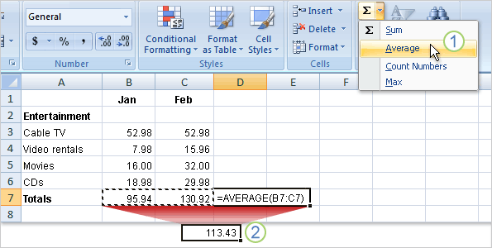
Find an average
You can use the AVERAGE function to find the mean average cost of all entertainment for January and February.
Excel will enter the formula for you.
Click in cell D7, and then:
On the Home tab, in the Editing group, click the arrow on the Sum button, and then click Average in the list.
Press ENTER to display the result in cell D7.
Notes:
The Sum button is also located on the Formulas tab, in the Function Library group.
After you click Average in step 1, the formula =AVERAGE(B7:C7) appears in the formula bar near the top of the worksheet. You could also type this formula directly into the cell.

Slide 49
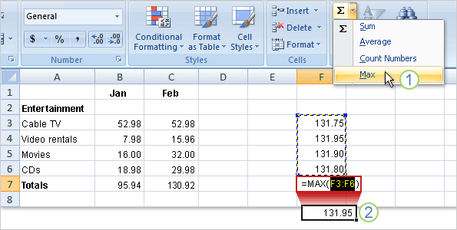
Find the largest or smallest value
The MAX function finds the largest number in a range, and the MIN function finds the smallest number in a range.
The picture illustrates the use of MAX.
Start by clicking in cell F7. Then:
On the Home tab, in the Editing group, click the arrow on the Sum button, and then click Max in the list.
Press ENTER to display the result in cell F7. The largest value in the series is 131.95.

Slide 50
Find the largest or smallest value
The MAX function finds the largest number in a range, and the MIN function finds the smallest number in a range.
The picture illustrates the use of MAX.
To find the smallest value in the range, you would click Min in the list and press ENTER.
The smallest value in the series is 131.75.

Slide 51
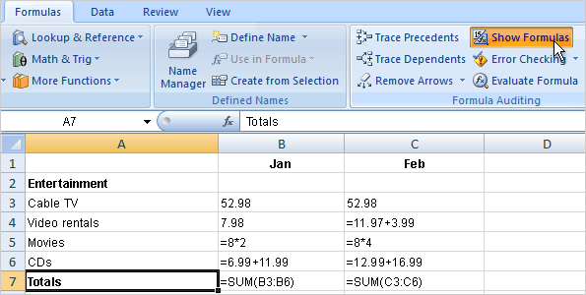
Print formulas
You can print formulas and put them up on your bulletin board to remind you how to create them.
But first, you need to display the formulas on the worksheet.
Here’s how:
Click the Formulas tab.
In the Formula Auditing group, click Show Formulas .

Slide 52
Print formulas
You can print formulas and put them up on your bulletin board to remind you how to create them.
But first, you need to display the formulas on the worksheet.
Here’s how:
Click the Microsoft Office Button in the upper-left corner of the Excel window, and click Print.
Tip: You can also press CTRL+` to display and hide formulas.

Slide 53
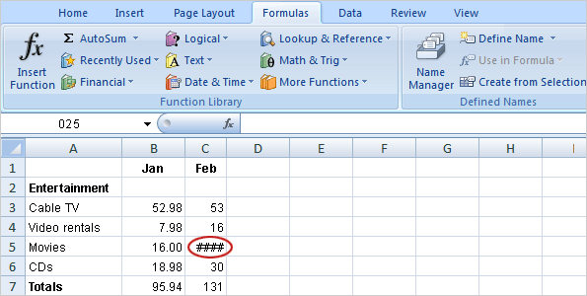
What’s that funny thing in my worksheet?
Sometimes Excel can’t calculate a formula because the formula contains an error.
If that happens, you’ll see an error value in a cell instead of a result.
Here are three common error values:
#### The column isn’t wide enough to display the contents of the cell. To fix the problem, you can increase column width, shrink the contents to fit the column, or apply a different number format.

Slide 54
What’s that funny thing in my worksheet?
Sometimes Excel can’t calculate a formula because the formula contains an error.
If that happens, you’ll see an error value in a cell instead of a result.
Here are three common error values:
#REF! A cell reference isn’t valid. Cells may have been deleted or pasted over.
#NAME? You may have misspelled a function name or used a name that Excel doesn’t recognize.

Slide 55
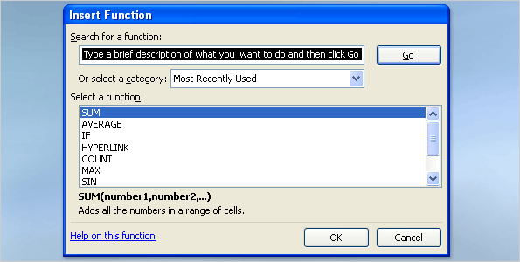
Find more functions
Excel offers many other useful functions, such as date and time functions and functions you can use to manipulate text.
To see all the other functions:
Click the Sum button in the Editing group on the Home tab.
Click More Functions in the list.
In the Insert Function dialog box that opens, you can search for a function.

Slide 56
Find more functions
Excel offers many other useful functions, such as date and time functions and functions you can use to manipulate text.
In addition to searching for a function in this dialog box, you can select a category and then scroll through the list of functions in the category.
And you can click Help on this function at the bottom of the dialog box to find out more about any function.
Notes:
Tip: You can also see other functions by clicking the Formulas tab.

Slide 57
Suggestions for practice
Find an average.
Find the largest number.
Find the smallest number.
Display and hide formulas.
Create and fix error values.
Create and fix the error value #NAME?.
Online practice (requires Excel 2007)
Notes:
[Note to trainer: With Excel 2007 installed on your computer, you can click the link in the slide to go to an online practice. In the practice, you can work through each of these tasks in Excel, with instructions to guide you. Important: If you don’t have Excel 2007, you won’t be able to access the practice instructions.]

Slide 58
Test 3, question 1
How would you print formulas? (Pick one answer.)
Click the Microsoft Office Button, and then click Print.
Click Normal on the View tab at the top of the screen, click the Microsoft Office Button, and then click Print.
In the Formula Auditing group on the Formulas tab, click Show Formulas; then click the Microsoft Office Button, and click Print.

Slide 59
Test 3, question 1: Answer
In the Formula Auditing group on the Formulas tab, click Show Formulas; then click the Microsoft Office Button, and click Print.
Clicking Show Formulas displays the formulas on your worksheet before you print.

Slide 60
Test 3, question 2
What does #### mean? (Pick one answer.)
The column is not wide enough to display the content of the cell.
The cell reference is not valid.
You have misspelled a function name or used a name that Excel doesn’t recognize.

Slide 61
Test 3, question 2: Answer
The column is not wide enough to display the content of the cell.
You can increase the column width to display the content.

Slide 62
Test 3, question 3
What is the keyboard shortcut to display formulas on the worksheet? (Pick one answer.)
CTRL+`
CTRL+:
CTRL+;

Slide 63
Test 3, question 3: Answer
CTRL+`
The ` is next to the 1 key on most keyboards. The keyboard shortcut displays and hides formulas.

Slide 64
Quick Reference Card
For a summary of the tasks covered in this course, view the Quick Reference Card.

