Slide 1



Professional Employer Private Limited
TOPIC MS EXCEL
Facilitator: Aiman Saleem

Slide 2
INDEX
INTRODUCTION TO EXCEL…………………………………....
Error Messages (Cell Reference)……………………………
CONDITIONAL FORMATTING……………………………......
SORTING………………………………………………………….......
FUNCTIONS……………………………………………………..……
PIVOT TABLE ……………………………………………………..….
SHORTCUT KEYS………………………………………..........…..
3
4
5-6
7
8-15
16-17
18-20

Slide 3
INTRODUCTION TO MS-EXCEL
Excel is a computer program used to create electronic spreadsheets.
Within excel user can organize data ,create chart and perform calculations.
Excel is a convenient program because it allow user to create large spreadsheets, reference information, and it allows for better storage of information.
Excels operates like other Microsoft(MS) office programs and has many of the same functions and shortcuts of other MS programs.

Slide 4
Error Messages (Cell Reference)
######### | Column not wide enough
#DIV/0! | Dividing by zero
#REF | Cell reference not valid (Deleted cell, pasted over)
For example click here

Slide 5
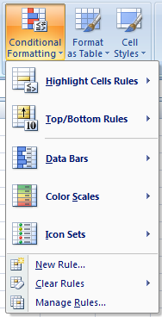
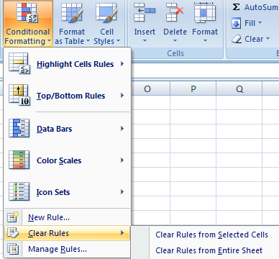
CONDITIONAL FORMATTING
TO APPLY CONDITIONAL FORMATTING:
Select the cells you would like to format.
Select the Home tab.
Locate the Styles group.
Click the Conditional Formatting command. A menu will appear with your formatting options.
TO REMOVE CONDITIONAL FORMATTING:
Click the Conditional Formatting command.
Select Clear Rules.
Choose to clear rules from the entire worksheet or the selected cells.

Slide 6
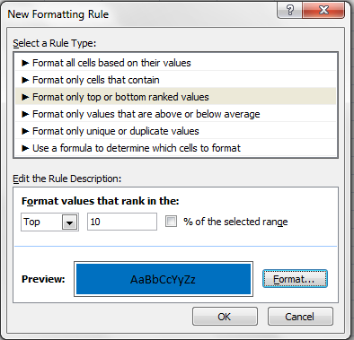
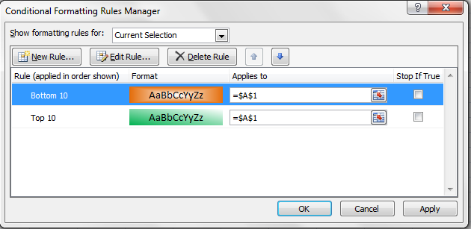
CONDITIONAL FORMATTING
Example
TO APPLY NEW FORMATTING:
Click the Conditional Formatting command. Select New Rules from the menu. There are different rules, you can apply these rules to differentiate particular cell.
TO MANAGE CONDITIONAL FORMATTING:
Click the Conditional Formatting command.
Select Manage Rules from the menu. The Conditional Formatting Rules Manager dialog box will appear. From here you can edit a rule, delete a rule, or change the order of rules.

Slide 7
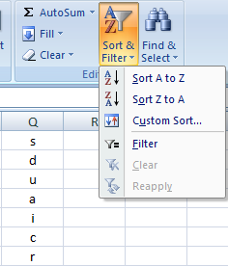

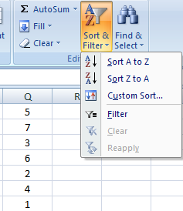

SORTING
TO SORT IN ALPHABETICAL ORDER:
Select a cell in the column you want to sort (In this example, we choose a cell in column Q).
Click the Sort & Filter command in the Editing group on the Home tab.
Select Sort A to Z. Now the information in the Category column is organized in alphabetical order.
Example
TO SORT FROM SMALLEST TO LARGEST:
Select a cell in the column you want to sort (In this example, we choose a cell in column Q).
Click the Sort & Filter command in the Editing group on the Home tab.
Select From Smallest to Largest. Now the information is organized from the smallest to largest amount.

Slide 8
FUNCTIONS
INDEX MATCH FUNCTION
SYNTAX OF Index Match
=INDEX('SOURCE-1'!$D$2:$D$22,MATCH('TARGET-1'!D5,'SOURCE-1'!$C$2:$C$22,0))
Employee code | Insurance policy number | AMOUNT
1114 | 101010 | 10000
1273 | 101011 | 12000
1487 | 101012 | 15000
1002 | 101013 | 10000
1556 | 101014 | 12000
1073 | 101015 | 15000
1392 | 101016 | 10000
1405 | 101017 | 12000
1619 | 101018 | 15000
1103 | 101019 | 10000
1561 | 101020 | 12000
1811 | 101021 | 15000
1734 | 101022 | 10000
1810 | 101023 | 12000
1344 | 101024 | 15000
1254 | 101025 | 10000
1738 | 101026 | 12000
1452 | 101027 | 15000
1001 | 101028 | 10000
1869 | 101029 | 12000
PULL THE USER ID & AMOUNT FROM SOURCE-1
Insurance policy number |  | 101011
Employee code |  | 1273 | INDEX / MATCH
AMOUNT |  | 12000 | INDEX / MATCH
Example
From Insurance policy number we are finding employee code and amount. This formula is used as an alternate of VLOOKUP

Slide 9
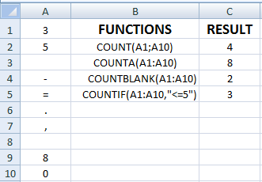
COUNT FUNCTIONS
SYNTAX OF FUNCTIONS
1. COUNT
=COUNT(VALUE1,VALUE2,…)
2. COUNTA
=COUNTA(VALUE1,VALUE2,…)
3. COUNTBLANK
=COUNTBLANK(RANGE)
4. COUNTIF
=COUNTIF(RANGE,CRITERIA)
=
=
=
=
Example
1. 2. 3. 4.
COUNT ONLY CELLS THAT CONTAINS NUMBER.
COUNT CELLS THAT ARE NOT EMPTY.
COUNT CELLS THAT ARE BLANK.
COUNT NO. OF CELLS THAT MEET GIVEN CONDITION.

Slide 10
PIVOT TABLE
Pivot Table is one of the most powerful features in Excel. This presentation describes Pivot Tables and Few Features of Pivot Table
A pivot table is a great reporting tool that sorts and sums independent of the original data layout in the spreadsheet. If you never used one, this below example will most interesting for you.

Slide 11
CREATING Pivot Table
For example Click here

Slide 12
SHORTCUT KEYS
PARTICULARS
EDIT THE ACTIVE CELL
CREATE A CHART
INSERT CELL COMMENT
FUNCTION DIALOGUE BOX
INSERT A NEW WORKSHEET
NAME MANAGER DIALOGUE BOX
VISUAL BASIC EDITOR
MACRO DIALOGUE BOX
HIDE THE SELECTED COLUMNS
UNHIDE THE COLUMNS
HIDE THE SELECTED ROWS
UNHIDE THE ROWS
SELECT ALL CELLS WITH COMMENT
KEYS
F₂
F₁₁
SHIFT + F₂
SHIFT + F₃
SHIFT + F₁₁
CTRL + F₃
ALT + F₁₁
ALT + F₈
CTRL + 0
CTRL + SHIFT + 0
CTRL + 9
CTRL + SHIFT + 9
CTRL + SHIFT + O

Slide 13
SHORTCUT KEYS
PARTICULARS
DOWN FILL
RIGHT FILL
ENTER SUM FUNCTION IN CELL
EURO SYMBOL
CENT SYMBOL
POUND SYMBOL
YEN SYMBOL
ENTER NEW LINE IN ACTIVE CELL
CURRENT DATE
CURRENT TIME
SHOW FORMULA
SELECT ENTIRE COLUMN
SELECT ENTIRE ROW
KEYS
CTRL + D
CTRL + R
ALT + =
ALT + 0128
ALT + 0162
ALT + 0163
ALT + 0165
ALT + ENTER
CTRL + ;
CTRL + SHIFT + ;
CTRL + `
CTRL + SPACEBAR
SHIFT + SPACEBAR

Slide 14


