Slide 1
Utilizing Quick Access Toolbar in MS Excel
Prepared by: Aiman Saleem
Excel Expert
www.excel-expert.yolasite.com

Slide 2
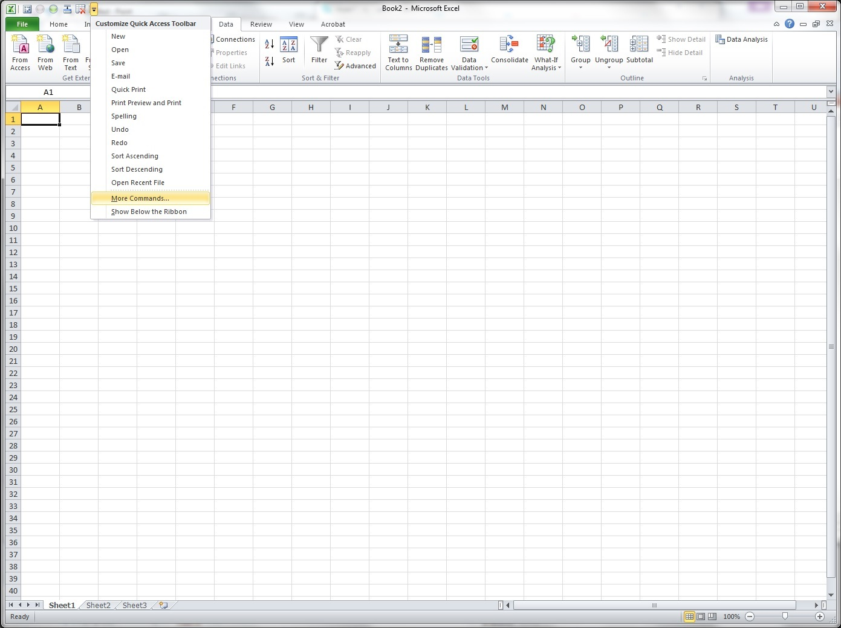
1) Click the Customize Quick Access Toolbar dropdown
2) Then click “More Commands…”

Slide 3
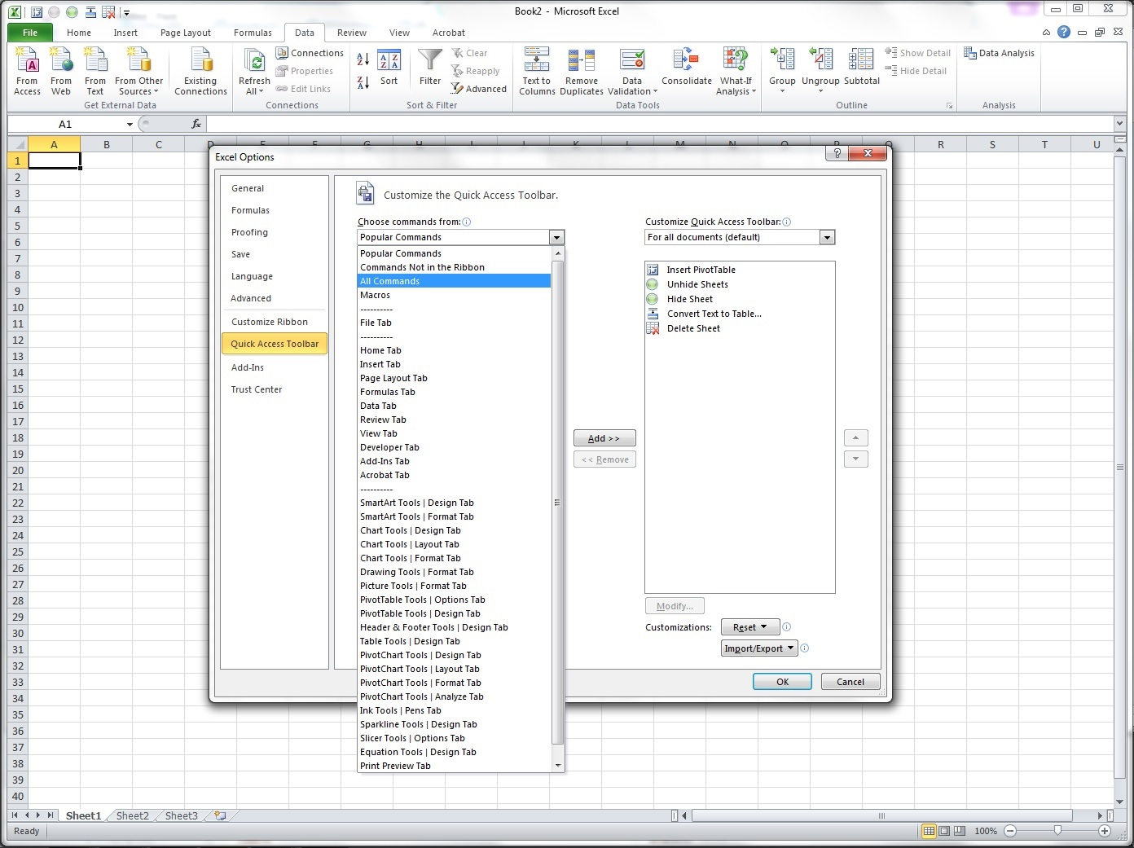
3) Click “Quick Access Toolbar” tab
4) Then select “All Commands” from this list

Slide 4
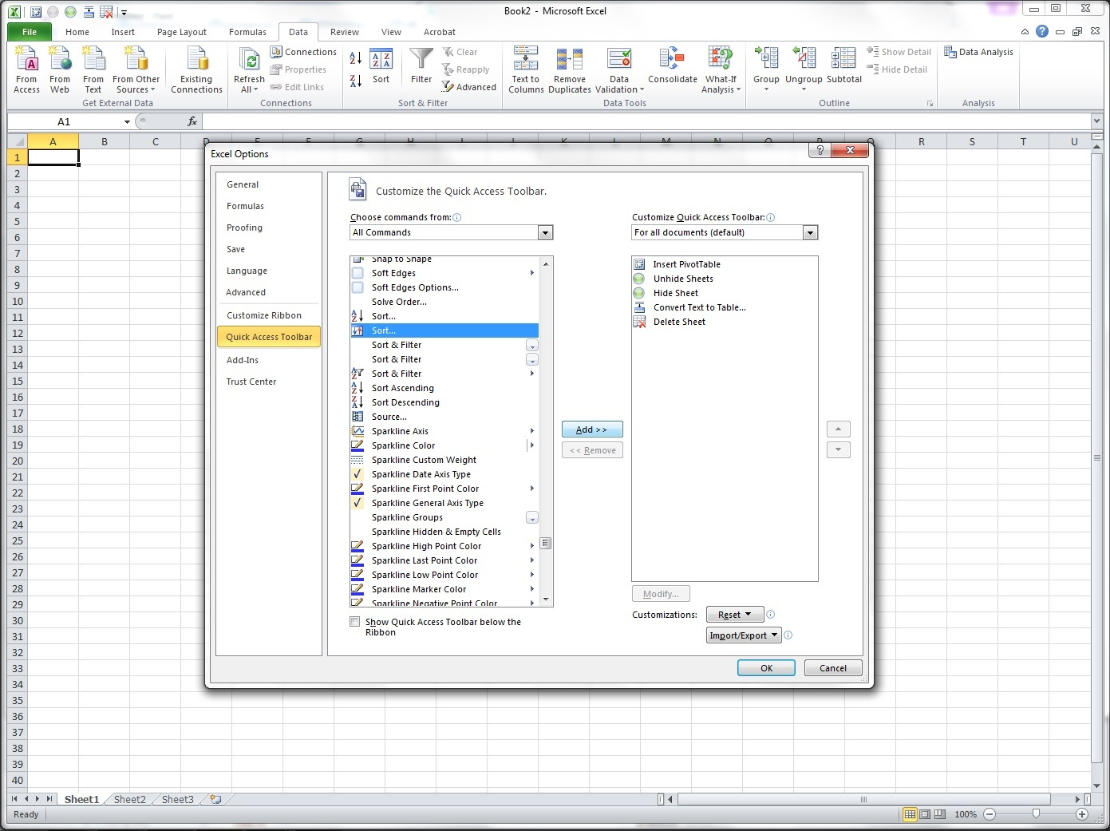
5) Select the command (s) you wish to add (ex: Sort)
6) Then click “Add >>” button to include it in your Quick Access Toolbar list

Slide 5
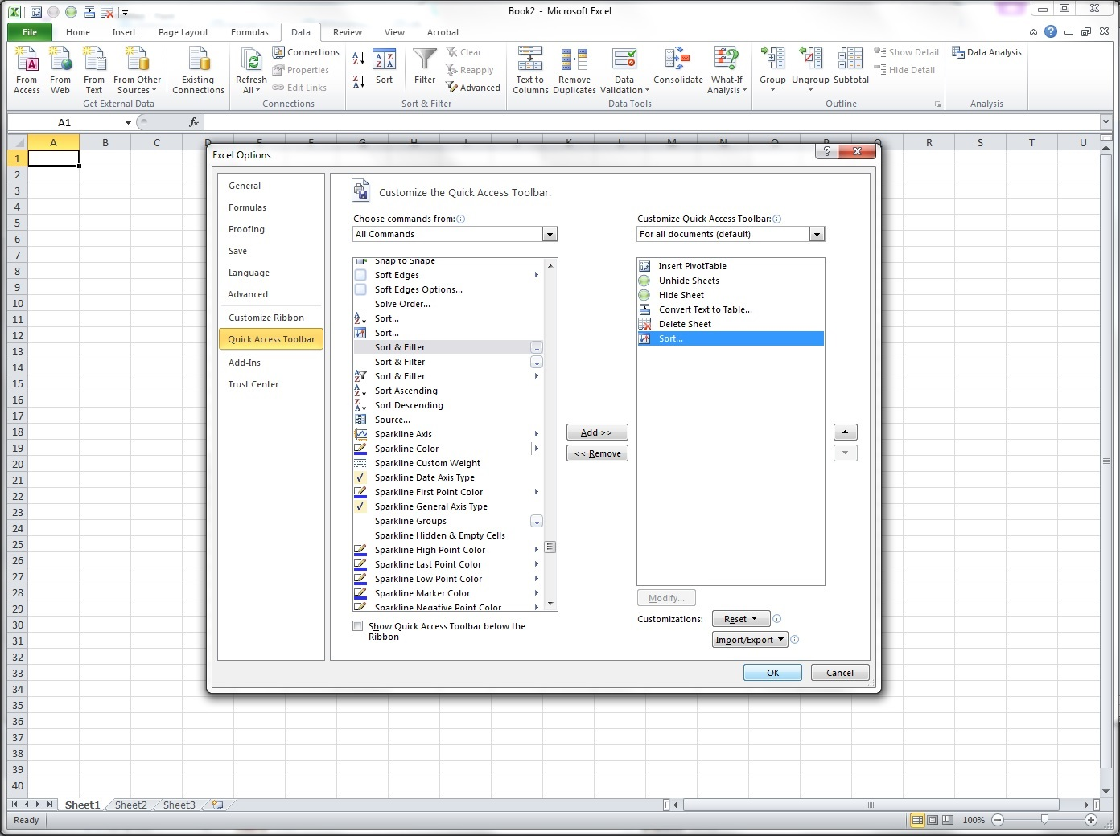
7) You may use these arrows to move up & down to arrange the commands
8) Then click “OK” button

Slide 6
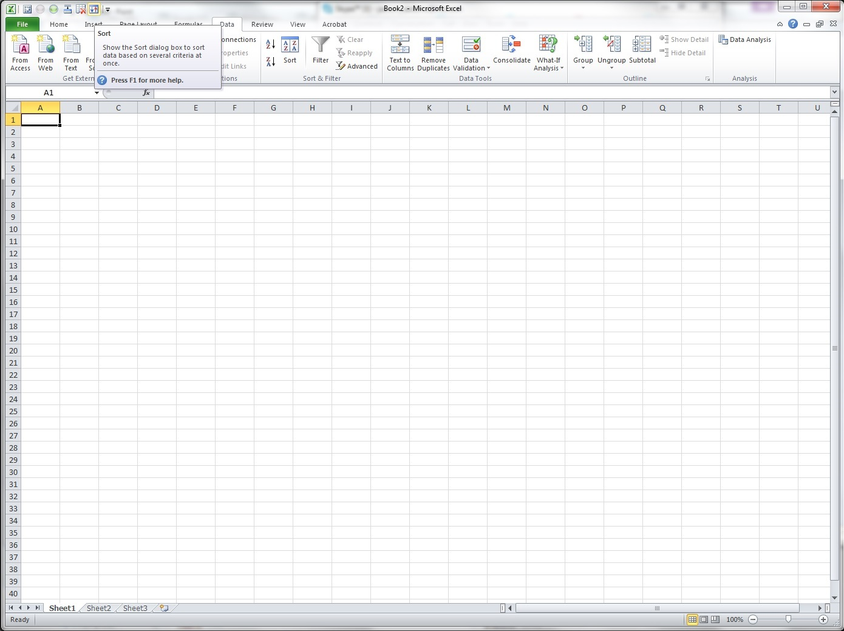
The “Sort” command is now included in the Quick Access Toolbar

Slide 7
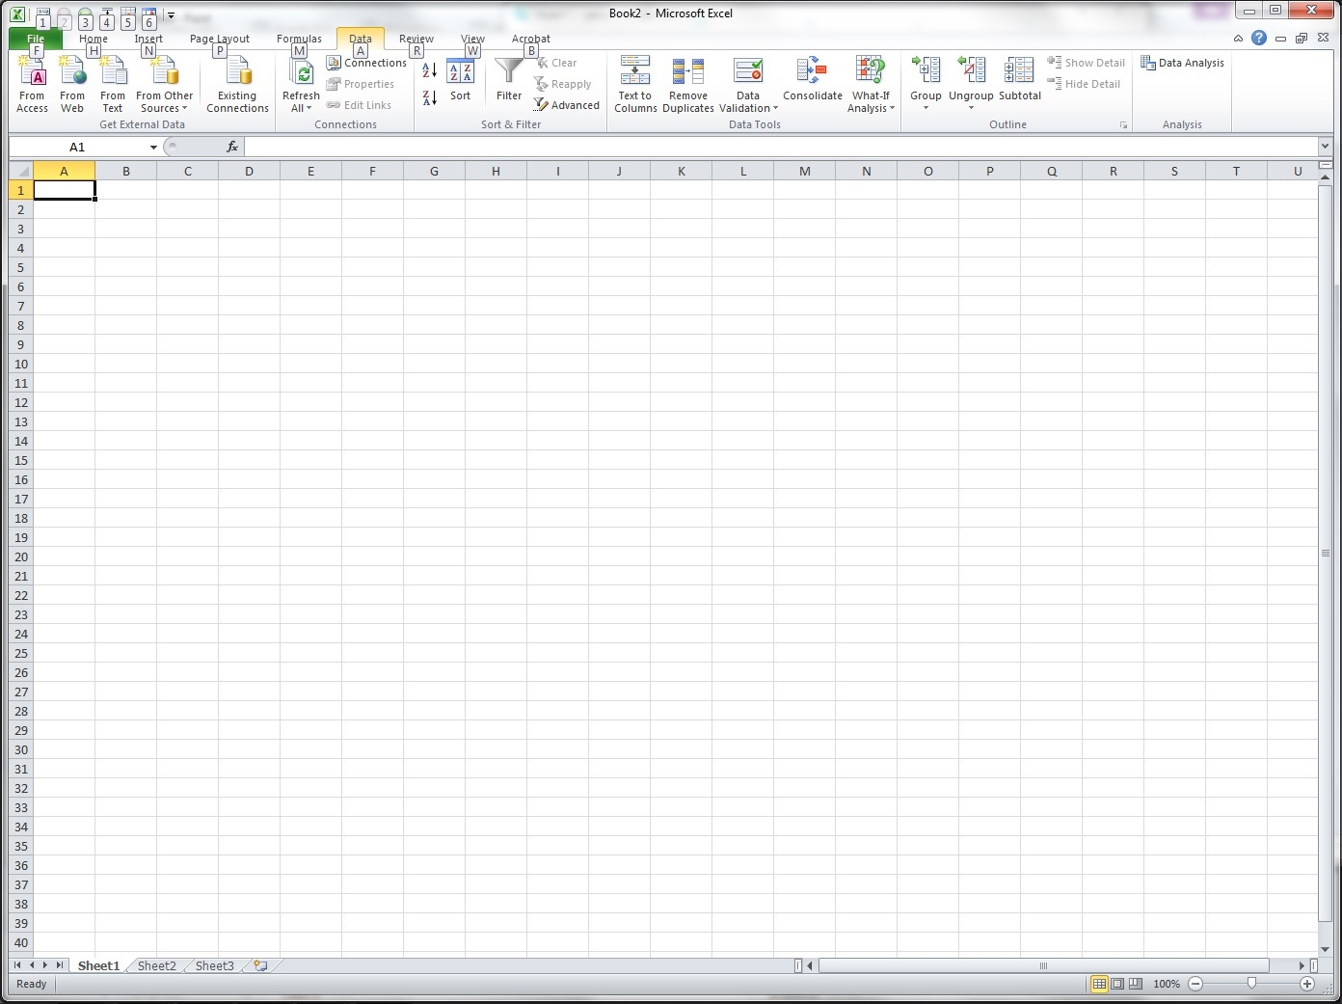
Press Alt button and you will see numbers appear for each command in the Quick Access toolbar. In my case, the Sort is number 6. Then I will be pressing Alt+6 every time I use Sort.
Note: You can set the arrangement of commands here. See Bullet 7.

Slide 8
Thank you Excel guys!!!

